Slide 1

INNO RESCUE
Stop Tragedy Before It Strikes

Slide 2
PROBLEM STATEMENT
Suicide is a significant global public health issue, with millions of lives lost each year. A substantial portion of suicides occurs in private settings, where early intervention is often challenging, especially in Hostels. To address this critical issue, there is a need for an advanced technological solution that can detect and respond to signs of suicide attempts involving hanging and alert emergency services .

Slide 3
PROPOSED SOLUTION
The proposed automated suicide prevention system integrates momentary push buttons, a microcontroller, a buzzer, a GSM module, and an LED indicator to detect and respond to potential hanging attempts. With a focus on sensitivity and reliability, the system provides immediate alerts through sound and visual cues while communicating distress messages and calls to predefined contacts like wardens, workers, and owners via the GSM module. It prioritizes user privacy, consent, and safety, featuring user-friendly deactivation options. Emphasizing clear protocols, education, and ethical considerations, the system aims to complement existing mental health support systems,potentially saving lives through faster emergency responses

Slide 4
PROJECT SCOPE
The scope of InnoRescue focuses on developing an innovative, life-saving device to prevent suicides involving ceiling fans. The project aims to integrate push-button sensors below the fan's cap to detect potential suicide attempts by monitoring unusual weight changes. Upon detection, the system will immediately activate an alarm (siren) and send automated SMS alerts and calls to emergency contacts such as wardens or family members.

Slide 5
TECHNOLOGY
Arduino Microcontroller
Arduino IDE
GSM Module integration

Slide 6
COMPONENTS
Arduino UNO
Push-button
GSM Module (SIM900A)
Siren/Buzzer
LED Indicators
Relay Module
12V Power Supply
Wires and Connectors
Breadboard or PCB
Special fan base

Slide 7
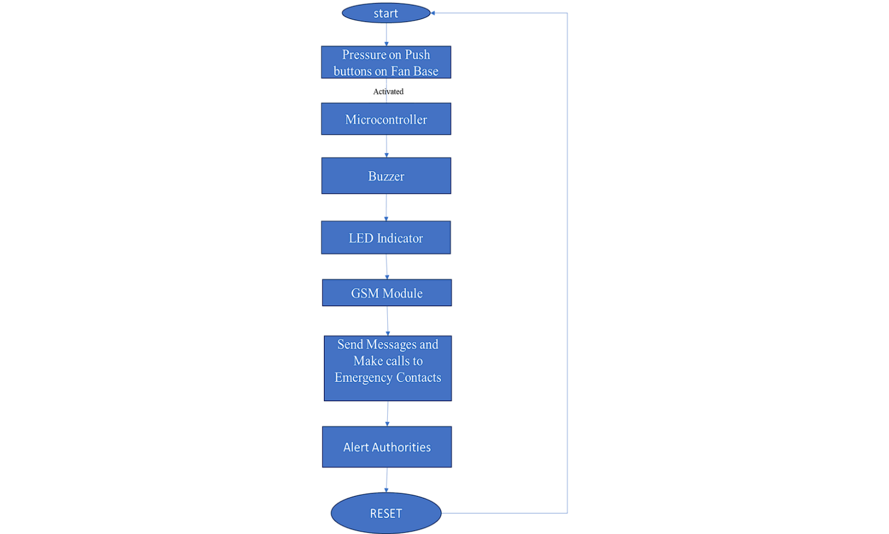
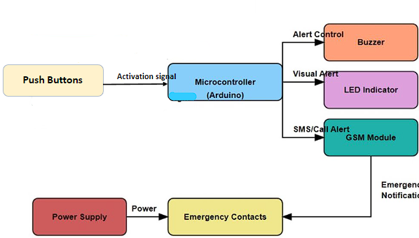
BLOCK DIAGRAM

Slide 8
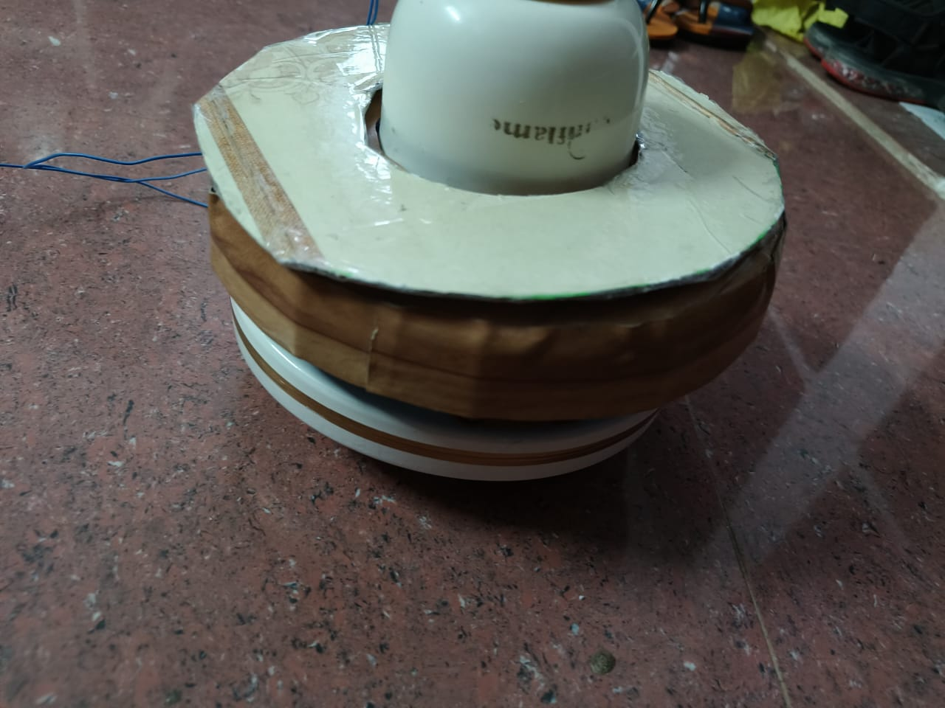
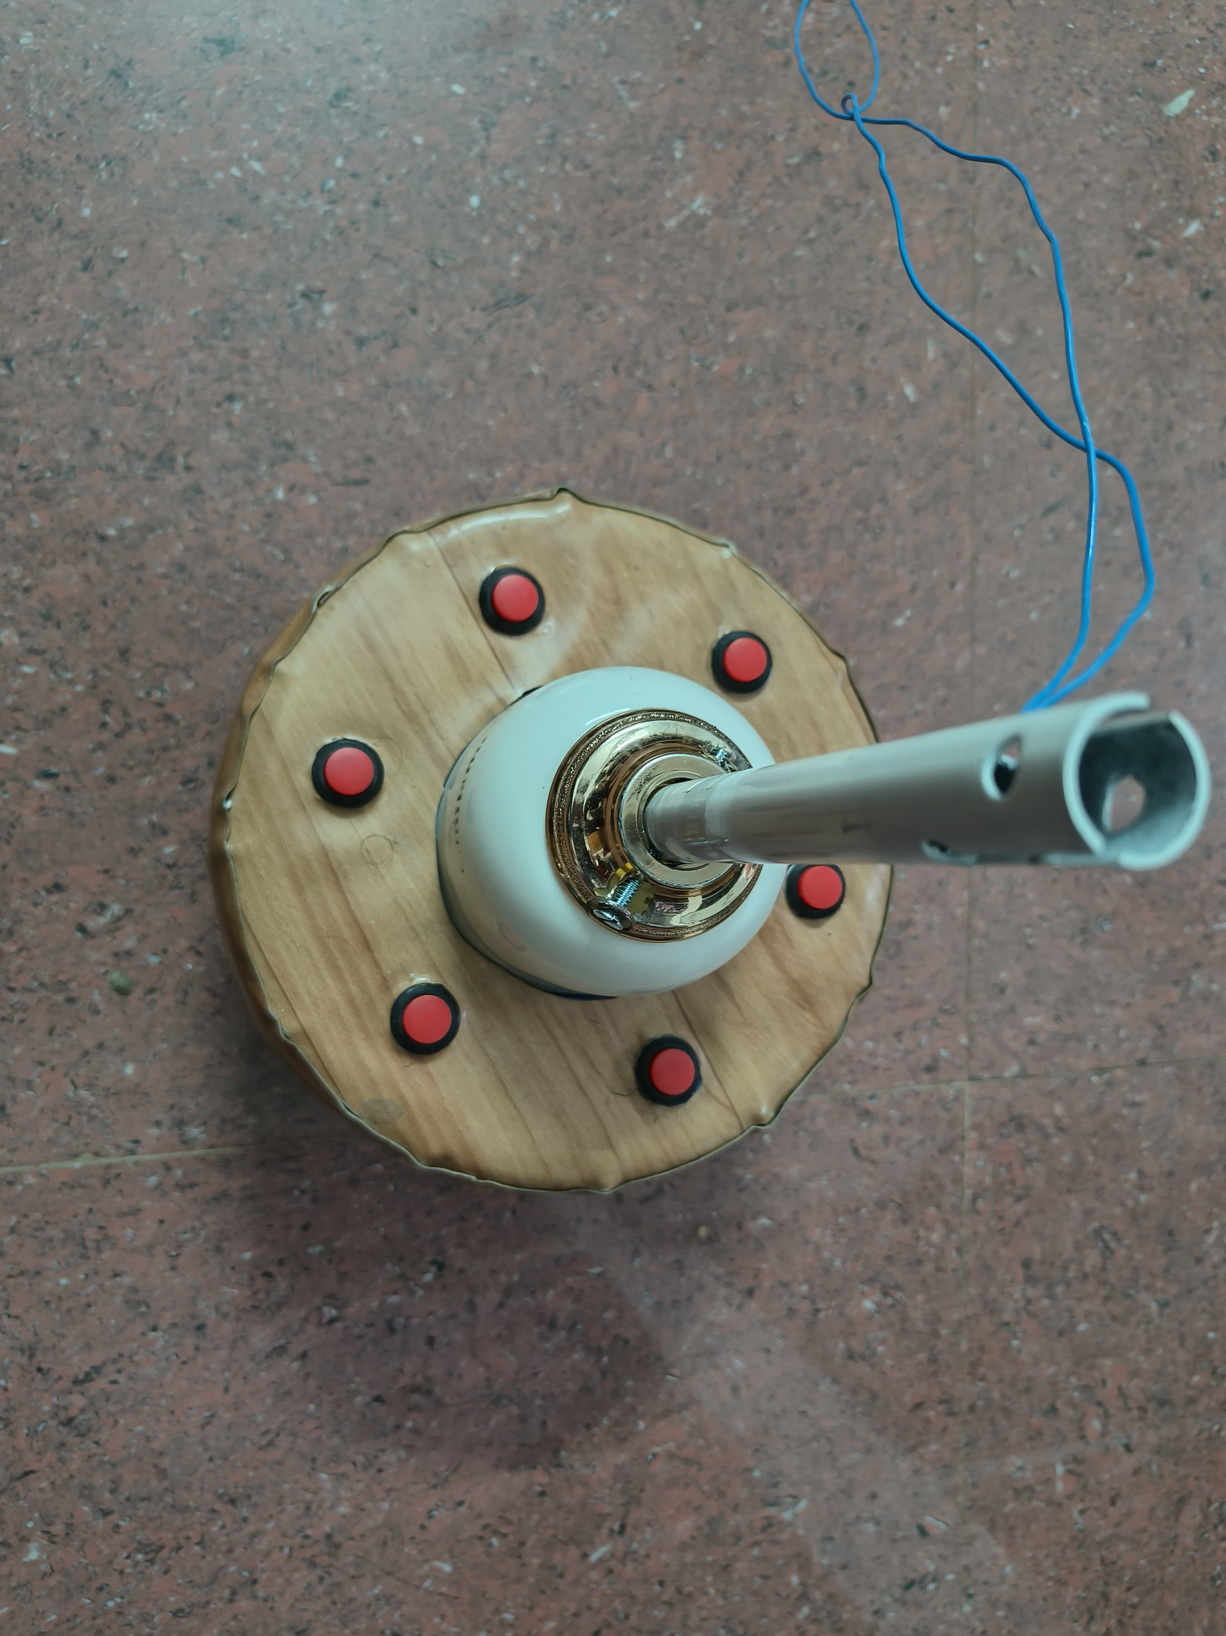
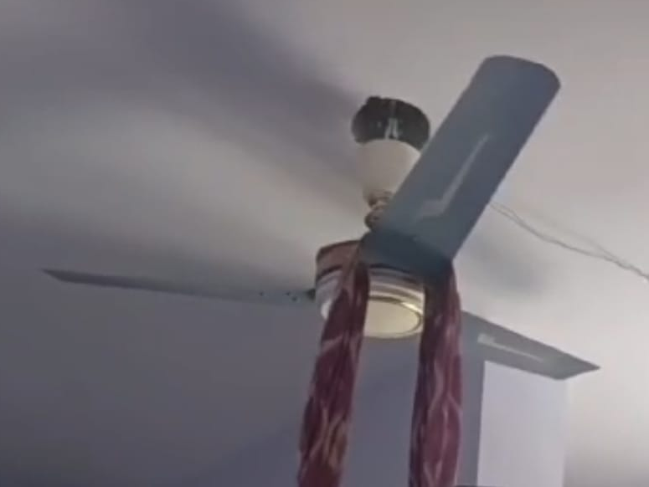
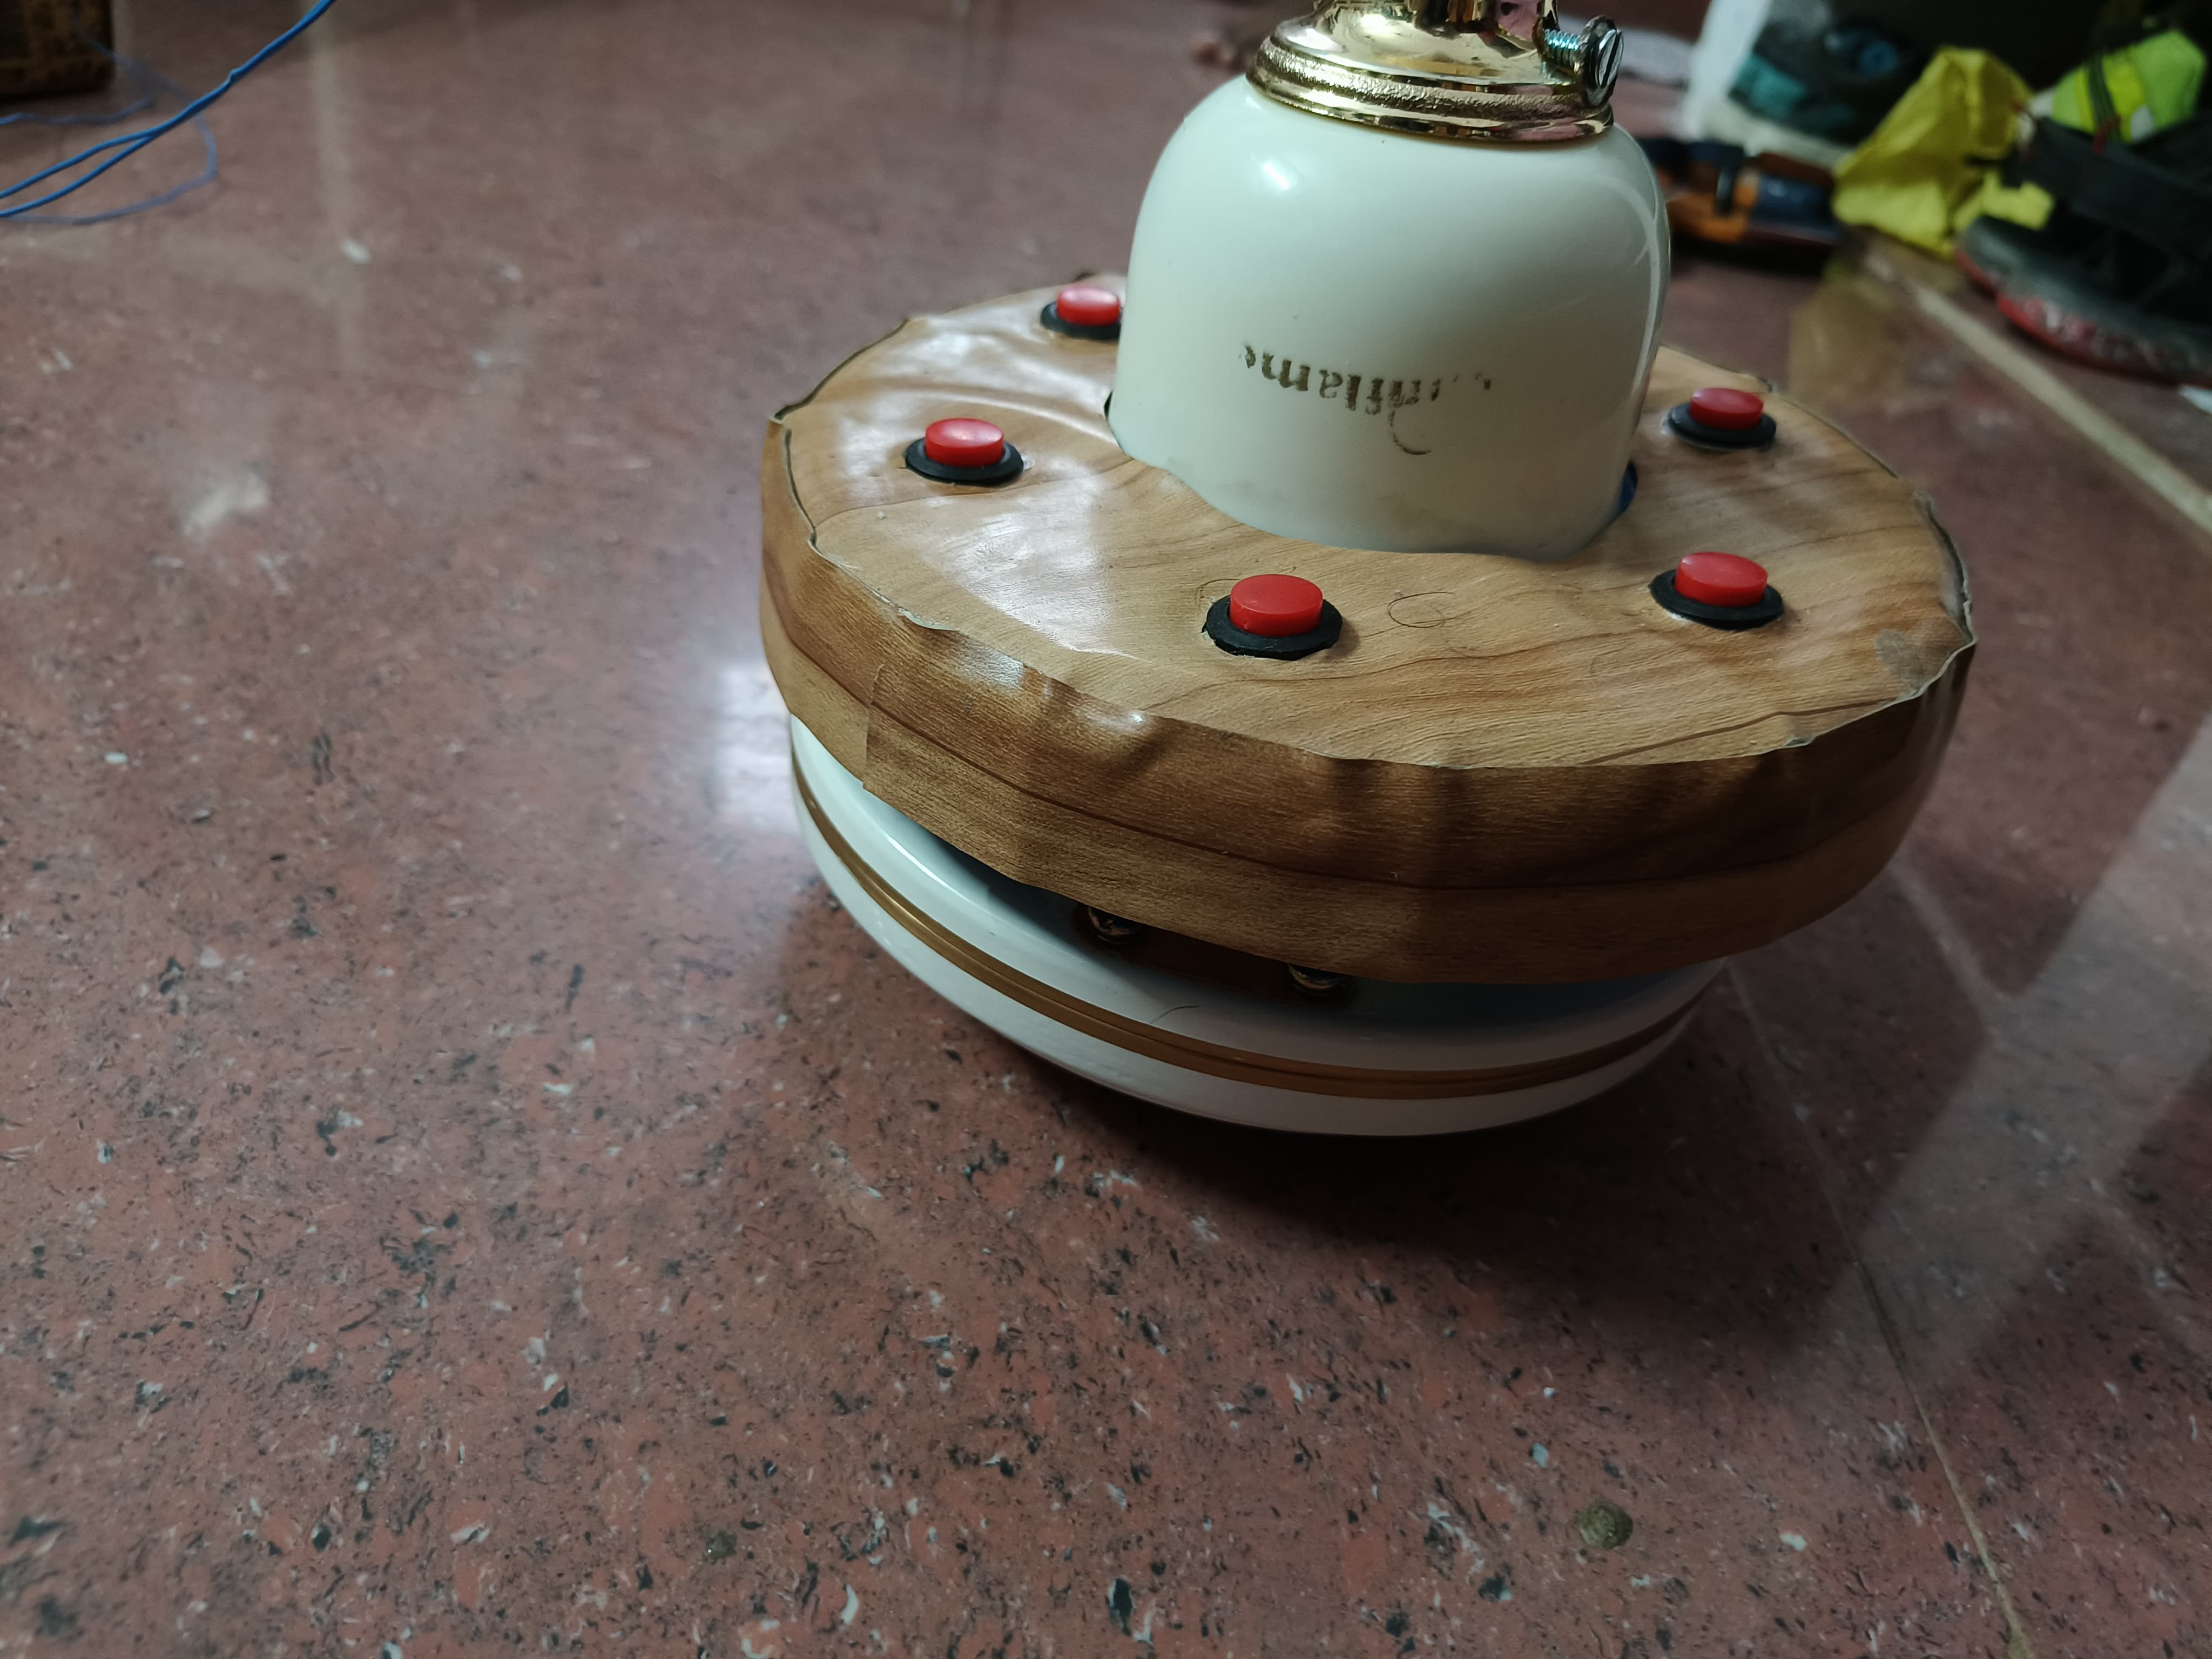
PROTOTYPE/ WORKING MODEL PICTURE

Slide 9
DEPLOYMENT
The InnoRescue system can be deployed in environments prone to potential suicide attempts, such as hostels, dormitories, and private homes. The push-button sensors are installed below the ceiling fan’s cap to detect any abnormal pressure. Once the system detects an anomaly, it triggers an immediate alarm and sends alerts via the GSM module to pre-designated emergency contacts. The deployment involves installing the sensors, connecting them to the Arduino system, setting up the GSM module, and configuring the emergency contact information. This ensures real-time detection, response, and alerting in case of emergencies.
Let say for suppose in 2 rooms there are 8 fans the cost will be:6000/-

Slide 10
CONCLUSION
The InnoRescue project represents a vital step forward in using technology to prevent suicide. By integrating a simple yet effective mechanism with push-button sensors and leveraging GSM communication, the system offers timely intervention in critical moments. Its ability to detect potential attempts and immediately trigger alarms and alerts ensures that help can be provided quickly, minimizing the risk of harm. The system's design prioritizes reliability and affordability, making it accessible for large-scale deployment in sensitive environments like hostels, dormitories, and private residences. This innovative solution highlights the role of technology in safeguarding lives and brings hope for a future where timely intervention can significantly reduce suicide rates.

